Slide 1
SQL: An Overview
Aubrey Smiley McAuliffe and Matt Sparr

Slide 2
Relational Databases
Use Tables to Store Information
Data is organized in rows and columns
Every entity has many aspects linked to it
Each table in the database has keys which link it to other tables
How do we muddle through the separate tables and work with the data scattered through them?
Why don’t people put all the information in a single file instead of in a bunch of related tables?

Slide 3
Illicit Finance and Relational Databases
Al Qaida and the Taliban prefer not to file tax returns or have their purchases audited
Legitimate businesses can boost profits by acting as a front in:
Making everyday purchases to launder illicit funds
Transferring funds internationally
Making large purchases that would only be appropriate for their business
Businesses who transfer money between two separate geographic entities can be called Hawala (or Hundi)
This is fine, as long as they register and consent to being audited
Red Flags are raised when normal businesses do Hawala services on the side
Would they be caught by a simple audit of the company finances?
Not necessarily
Purchases, transfers, bank records, and customer information are needed to solve the puzzle
These data points are often kept by separate entities

Slide 4
Enter SQL
SQL = Structured Query Language
Databases are a container for a collection of interrelated tables. (.db files)
They can be accessed using external tools (such as Python)
SQL forms the basis for popular database applications, such as Oracle and Access
SQL vs SQLite:
SQL is a query language intended for specific types of database servers
SQLite is an embeddable Database Management System.
Public Domain
Doesn’t require a certain type of database server
It’s a direct file-system engine which uses SQL syntax

Slide 5
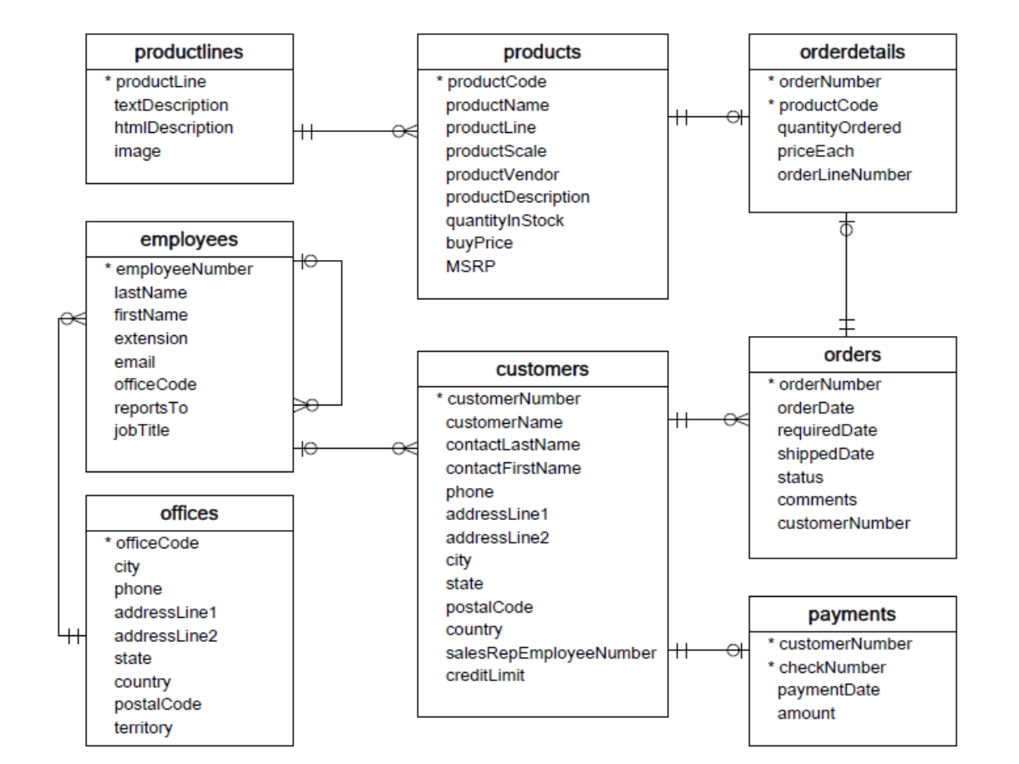
Database Diagrams (Entity-Relationship Diagrams)
ERD’s show:
All tables in Database
Each table’s primary key
unique identifiers for a table
indicated by *.
Relationships between features in tables
The nature of the relationship
One-to-one
One-to-many
Many-to-one

Slide 6
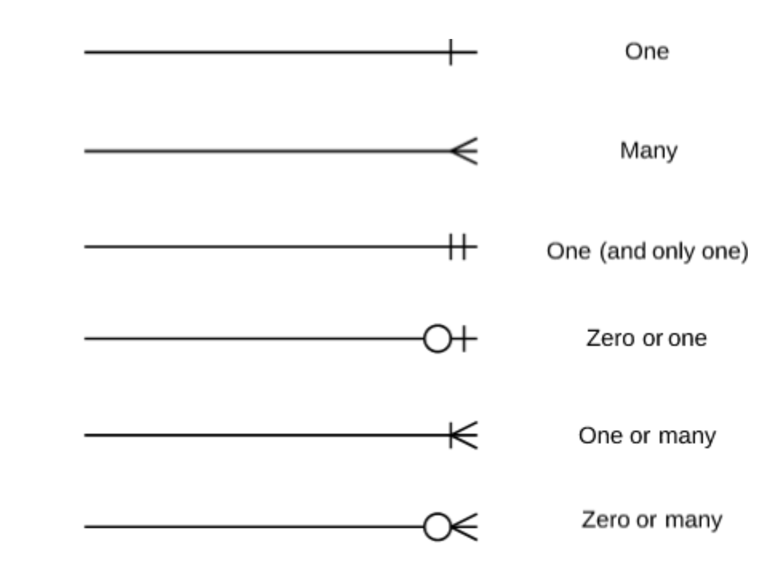
What do those symbols mean?

Slide 7
How do we catch a TTP Financier?
Signs of money laundering and illicit finance via Hawala include:
Purchases abroad which match exactly to a deposit made by a customer
Personal Checks deposited abroad
Purchases which are far more expensive than the product should be worth
Sales of sim cards or disposable phones in bulk
Bulk purchases by a customer of a cheap product for a lot of money
Ordering foreign currency from a local bank
Purchases made by a business that can’t be justified by the nature of the business

Slide 8
First Activity: What do we need from each table to find our Hawaladar?
Using the ERD provided on the next slide, work with a partner (live participants) or on your own (asynchronous) to make your recipe. What do you need to put the puzzle together and which table can you get it from?
Which table and features do we wish we had and should perhaps put in a court order to collect?
Feature
Table of Origin

Slide 9
